Slide 1
GENDER DIVERSITY IN THE (ELECTRO)MOBILITY SECTOR
A SCALE & POLIS Just Transition webinar
- 8th March 2024 -

Slide 2
This webinar will be recorded.

Slide 3
QUICK PRESENTATION
10 MIN
DISCUSSION + Q&A
50 MIN
AGENDA
Karen Vancluysen - POLIS Network
Afroditi Stamelou - CERTH
Raphaël Héliot - AVERE
Kanika Arora - Enedis
Moderation: Pedro Gomes & Juliette Thijs, POLIS

Slide 4
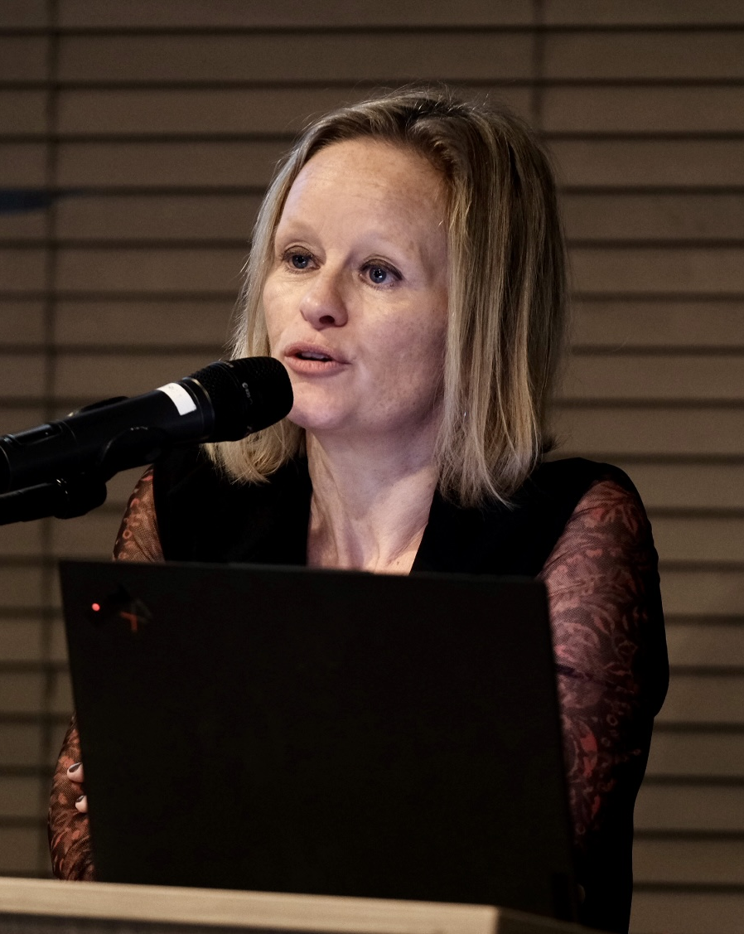
Meet our speakers
Karen Vancluysen
Secretary General, POLIS Network
Afroditi Stamelou
Senior Project Manager – Research Associate, CERTH
Kanika Arora
Project Intern
SCALE, Enedis
Raphaël Héliot
Policy Manager, AVERE

Slide 5
Who are we?

Slide 6
POLIS is a network of over 100 European cities and regions
improving urban mobility
The Just Transition Taskforce aims to bring real action towards ensuring that the shift to more sustainable urban mobility leaves no one behind

Slide 7
SCALE is a 3-year project (2022-2025) funded by the Horizon Europe Programme. It aims to advance smart charging infrastructure for electric vehicles and facilitate the mass deployment of electromobility
https://scale-horizon.eu/
It tests innovative V2X solutions through 13 use cases in real-life pilot sites.
The consortium includes 29 partners and is coordinated by ElaadNL

Slide 8
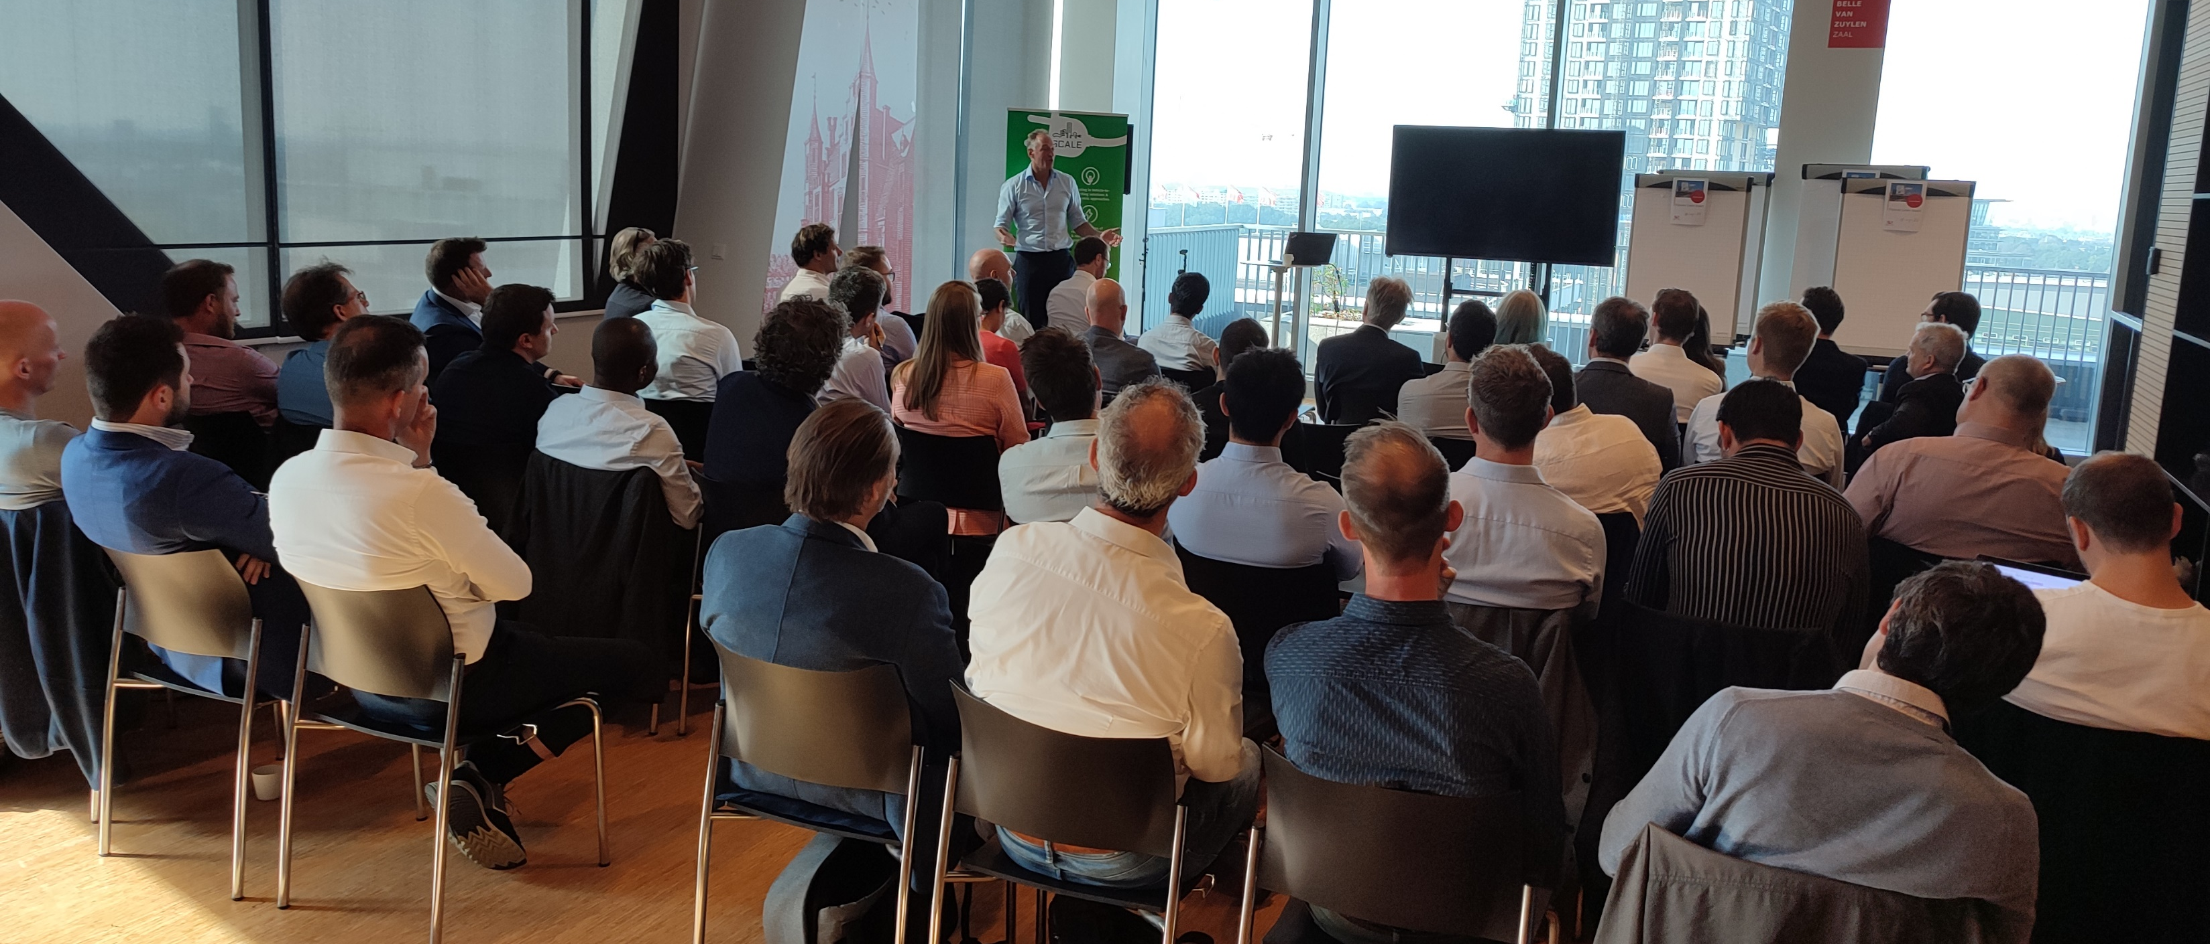
SCALE, moving forward!

Slide 9
Let’s dig into the data

Slide 10
Data can be asymmetric — 40 % of the aviation sector is made up of women, but only 6% of pilots are women globally.
Source: European Institute for Gender Equality.
Only 22% of the transport workforce in the European Union are women. In land transport, women represent only 10%.
Source: European Union, 2018
Only 8% of transport cabinet ministers were women in 2023. That’s almost the last position out of all cabinet roles, just before religious affairs – which is last.
Source: United Nations Women
“The (average) EU BEV driver is represented as a -35-year-old male, living in a detached house, and with a monthly income between 2,000 € and 3,999 € who has a university or higher education diploma.”
Source: EAFO, Consumer Monitor 2022

Slide 11
Gender
≠
Women

Slide 12
We need everyone on board!

Slide 14
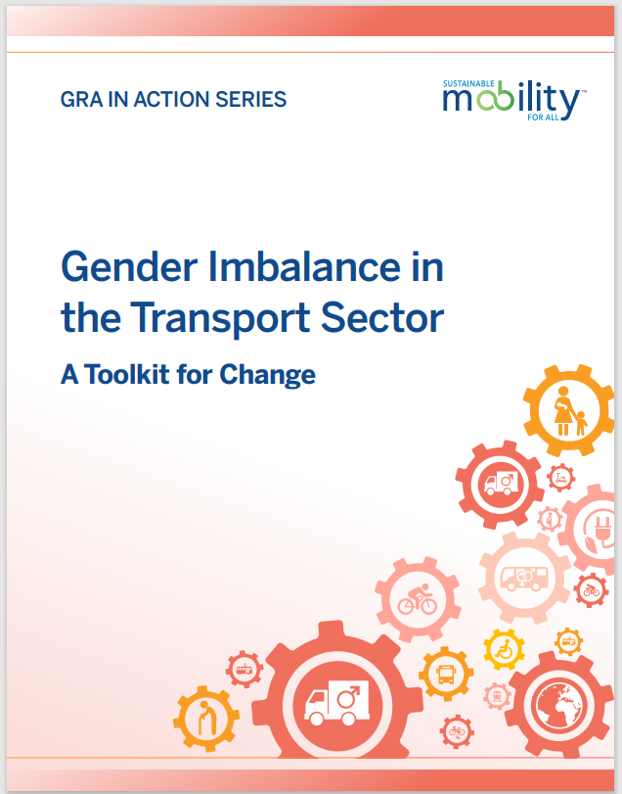
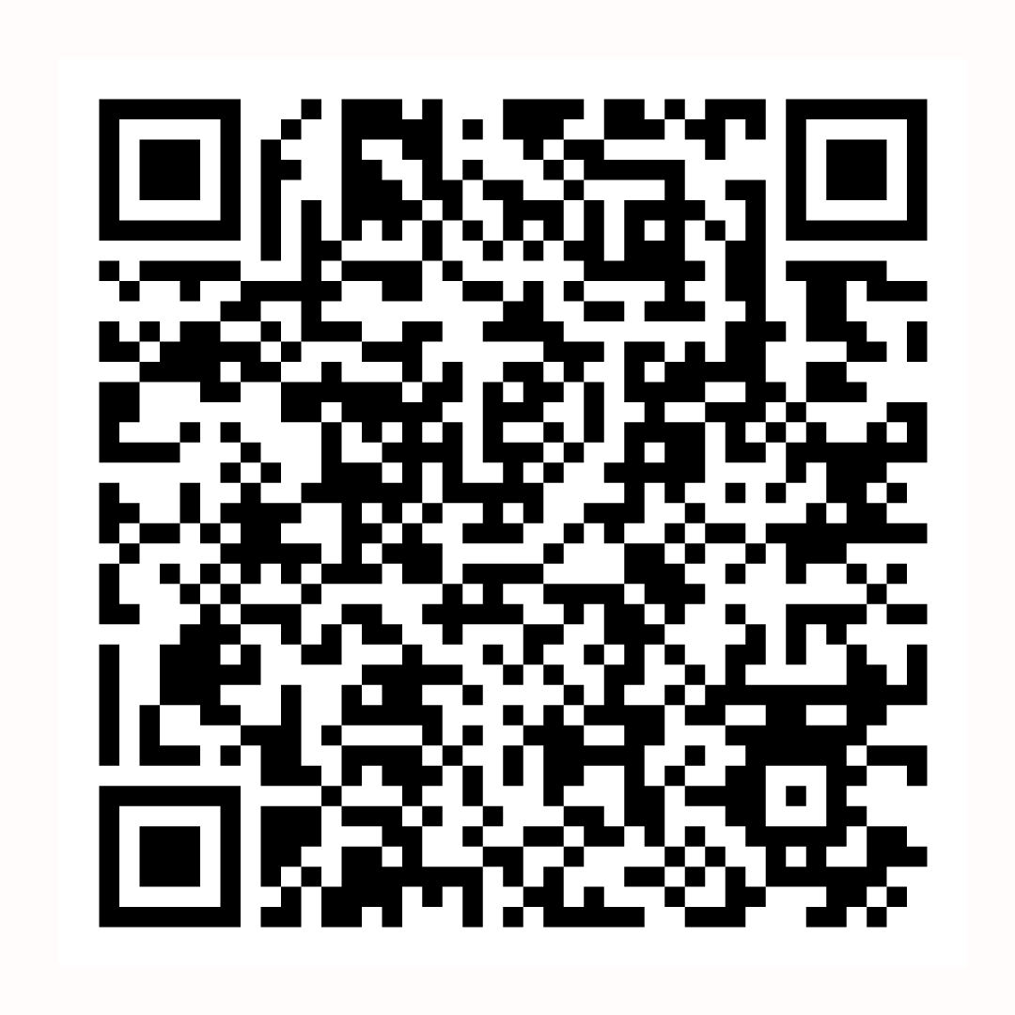
Five entry barriers for women to join and evolve in the transport sector were identified in the SUM4ALL report following desktop research, 23 interviews & 300 survey responses.
Gender stereotyping for certain jobs, especially technical ones
Discriminatory work cultures
Lack of flexible working and childcare provision
Invisible glass ceilings and restricted career options
Gender equity and its relationship
with wider diversity, behavior and culture change.
https://www.sum4all.org

